Slide 1
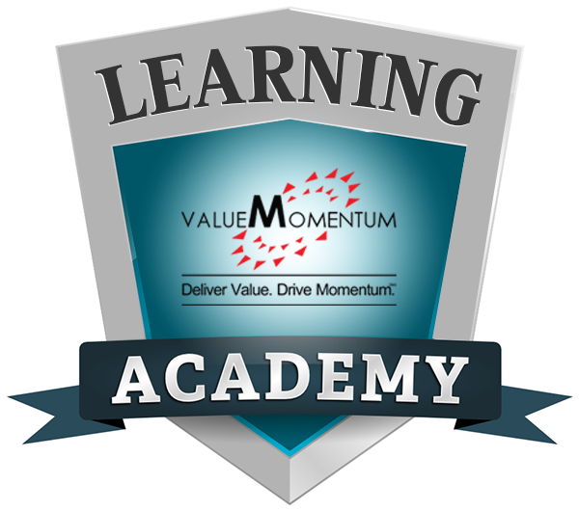
Workers Compensation and Employers Liability Insurance

Slide 2
Objectives
To provide an overview of loss exposures faced with employees
To understand the scenarios which can create WC and EL claims
To provide an overview of coverages and benefits offered as part of workers’ compensation and employers’ liability insurance
To understand what types of losses are excluded in the WC policy
Note: All Information contained herein is proprietary & confidential material of ValueMomentum Inc. All rights are reserved.

Slide 3
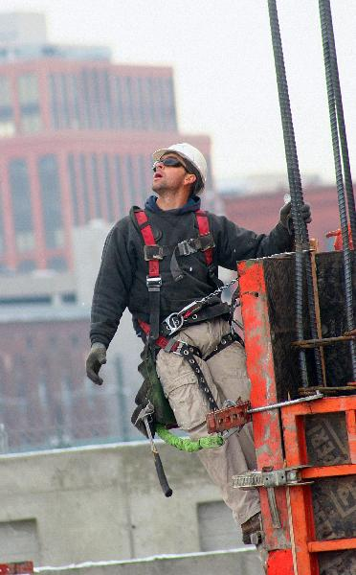
Workers' Compensation
Workers Compensation and EL Insurance responds to two basic loss exposure faced by employer:
The legal responsibility to pay benefits to employees as required by state workers compensation statutes.
The cost to defend against and possibly pay, liability claims made against the employer on account of bodily injury to an employee.
Note: All Information contained herein is proprietary & confidential material of ValueMomentum Inc. All rights are reserved.
Notes:
https://youtu.be/spL7QoQ5T_8
https://howmuch.net/costs/workers-compensation
https://www.allianz.com.au/business/workers-compensation/

Slide 4
Workers' Compensation
Overexertion
Muscle is pulled, or a joint is forced to move beyond its typical range of motion.
Factory jobs, construction jobs, or jobs where physical labor is necessary.
Slip or Trip and Falls
Workers slipping on wet floors around the workplace.
Individuals slipping and falling on snowy walkways.
Security workers, groundskeepers, and store clerks
Falls to a lower level
typically happens when a worker falls off a ladder, a roof, or falls down a flight of stairs. Roofers falling from a roof, construction workers slipping off a multi-level workspace, and teachers falling down stairs are all instances of falling to lower levels.
Bodily Reaction
A bodily reaction injury may occur when one trips or slips, avoids falling, but still sustains an injury such as a twisted or sprained ankle. Most commonly this is seen in police officers and nurses.
Note: All Information contained herein is proprietary & confidential material of ValueMomentum Inc. All rights are reserved.
Notes:
Overexertion arises when one lifts, pulls, pushes or throws something, causing injury. This injury occurs when a muscle is pulled, or a joint is forced to move beyond its typical range of motion. This is most commonly seen in factory jobs, construction jobs, or jobs where physical labor is necessary. This is also commonly seen in police officers. This is the most common injury seen in the workplace, according to a study from the Department of Labor.
2) Slip or Trip and Falls
Many of the slip, trip, and fall claims arise from workers slipping on wet floors around the workplace. Many of these cases are also related to individuals slipping and falling on snowy walkways. Many security workers, groundskeepers, and store clerks can fall victim to wet floors such as in a store with a freshly mopped floor, or a groundskeeper walking around the perimeter of the building.

Slide 5
Workers' Compensation
Struck by Object
While very plain, this injury occurs most commonly when something falls off a shelf, or things are dropped by another worker onto a lower level.
Office workers, along with restaurant & retail workers are all in danger of being struck by something.
Struck Against an Object
This injury occurs when an individual falls into something, or is physically forced into something such as a bookshelf, barricade, or other stationary object.
Office workers and factory workers can easily become a victim of falling into something.
Highway Incident
Especially in the cases of truck drivers, one of the top causes of injury is an accident while driving (for business purposes) on the roadway.
Common occurrence for traveling business representatives and police officers.
Note: All Information contained herein is proprietary & confidential material of ValueMomentum Inc. All rights are reserved.

Slide 6
Workers' Compensation
Machinery Accidents
In cases where large, heavy machinery has injured a worker by crushing or mutilating.
Most commonly seen in factories or construction workers, these accidents can have huge medical cost ramifications.
Many states have enacted laws that require training for employees before allowing them to operate equipment, along with maintenance requirements for machinery to keep it in a safe working state.
Keeping employees knowledgeable on equipment, along with keeping that equipment maintained are two important factors in protecting employees from injury.
Note: All Information contained herein is proprietary & confidential material of ValueMomentum Inc. All rights are reserved.
Notes:
8) Machinery Accidents
Machinery accidents are typically reported in cases where large, heavy machinery has injured a worker by crushing or mutilating. Most commonly seen in factories or construction workers, these accidents can have huge medical cost ramifications. Many states have enacted laws that require training for employees before allowing them to operate equipment, along with maintenance requirements for machinery to keep it in a safe working state. Keeping employees knowledgeable on equipment, along with keeping that equipment maintained are two important factors in protecting employees from injury.
9) Repetitive Motion
A repetitive injury is hard to pin-point, but is harder to prove. These injuries stem from workers doing the same motions over and over. Some examples of repetitive motion injuries can include using a mouse, sitting, lifting boxes, and working on an assembly line. Medically speaking, common injuries from repetitive or cumulative motions are tendonitis, carpal tunnel, and bursitis.
10) Workplace violence
According to preliminary data from the Bureau of Labor Statistics, "375 workers were killed in shootings while on the job in 2012. Robbers were the assailants in 33 percent of the workplace homicides involving shootings in 2012, while coworkers accounted for 13 percent. There were two incidents in 2012 where at least 5 people were killed in workplace shootings; a total of 12 workers died in these two incidents. From 1992 to 2012, 140 government workers were shot and killed by a coworker while on the job." While nobody expects violence in the workplace, it does happen.

Slide 7
Workers' Compensation
Repetitive Motion
A repetitive injury is hard to pin-point, but is harder to prove. These injuries stem from workers doing the same motions over and over.
Some examples of repetitive motion injuries can include using a mouse( Carpel Tunnel Syndrome), sitting, lifting boxes, and working on an assembly line.
Medically speaking, common injuries from repetitive or cumulative motions are tendonitis, carpal tunnel, and bursitis.
Workplace violence
There are four positions that make up 20% of the total number of injuries :
Police/Security officers, Nursing Aides/Orderlies/Attendants, Janitors/Cleaners, and Tractor-Trailer/Heavy Truck drivers.
Due to the high physical activity required by these positions, along with the exposure to dangerous situations, these jobs are considered some of the highest risk positions for injuries.
Note: All Information contained herein is proprietary & confidential material of ValueMomentum Inc. All rights are reserved.

Slide 8
Workers' Compensation
Provides insurance to cover medical care and compensation for employees who are injured in the course of employment, in exchange for mandatory relinquishment of the employee's right to sue his or her employer for the tort of negligence.
Workers compensation is a form of insurance designed to help employees recover from injuries sustained in the workplace.
There must be A CAUSE & EFFECT RELATION between the OCCUPATION & DISEASE
Every state has different laws pertaining to workers compensation programs.
Note: All Information contained herein is proprietary & confidential material of ValueMomentum Inc. All rights are reserved.
Notes:
Workers Comp- A state-sponsored system that pays monetary benefits to workers who become injured or disabled in the course of their employment. Sick pay may qualify as workers' compensation under certain conditions. Workers' compensation should not be confused with disability insurance or unemployment income; it only pays workers who are injured on the job, while disability insurance pays out regardless of when or where the insured is injured or disabled. Workers' compensation also does not cover unemployment. Unlike unemployment income or disability benefits, workers' compensation is always tax-free.

Slide 9
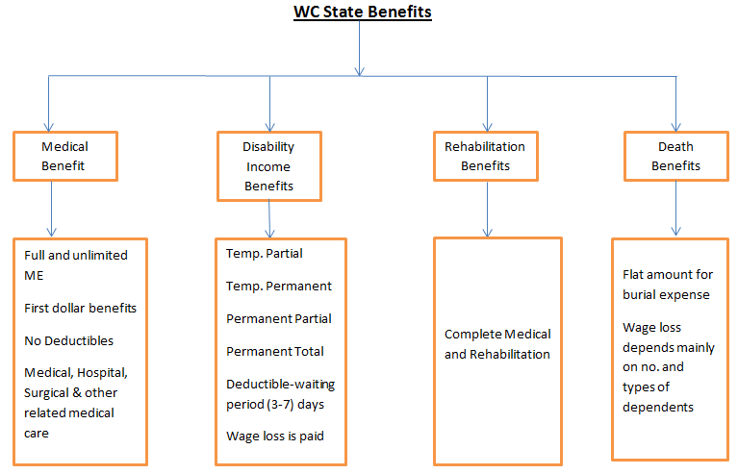
Workers' Compensation
Note: All Information contained herein is proprietary & confidential material of ValueMomentum Inc. All rights are reserved.

Slide 10
Workers' Compensation
Workers Compensation Exclusions:
Damages for injury or death for any illegally employed person.
Bodily injury intentionally caused by the insured.
Damages arising out of employment practices, including demotion, harassment, discrimination, and termination.
Fines or penalties imposed for violation of federal or state law.
Note: All Information contained herein is proprietary & confidential material of ValueMomentum Inc. All rights are reserved.
Notes:
https://youtu.be/TFp7-8x1fno

Slide 11
Employer’s Liability
An insurance policy that provides coverage for an employer's two key exposures arising out of injuries sustained by employees. Part One of the policy covers the employer's statutory liabilities under workers compensation laws, and Part Two of the policy covers liability arising out of employees' work-related injuries that do not fall under the workers compensation statute. In most states, the standard workers compensation and employers liability policy published by the National Council on Compensation Insurance (NCCI) is the required policy form.
Employer's liability insurance can be packaged with workers compensation insurance to further protect companies against the costs associated with workplace injuries, illnesses and deaths that aren’t covered under workers compensation. Employer's liability insurance is also called “part 2” of a workers’ compensation policy.
This coverage provided by part 2 of the workers compensation policy provides coverage to the insured (employer) for liability to employees for work-related bodily injury or disease, other than liability imposed on the insured by a workers compensation law.
Note: All Information contained herein is proprietary & confidential material of ValueMomentum Inc. All rights are reserved.
Notes:
A product for employers that protects them from major financial loss if a worker experiences a job-related injury or illness that workers compensation doesn’t cover

Slide 12
Employer’s Liability
The insurer agrees to defend the insured against claims and suits seeking covered damages. There are ways in which the employer can be held liable under the common law as the result of employee injury:
An employee of the insured sues a third party (such as machine manufacturer) for an occupational injury, and the third party then sues the employer. The third party’s suit might allege, for example, that the employer was negligent in maintaining the machine.
The spouse or family member of an injured employee sues the employer for loss of companionship or services (such as housekeeping or yard work that the employee would otherwise have performed) resulting from the injury.
Note: All Information contained herein is proprietary & confidential material of ValueMomentum Inc. All rights are reserved.

Slide 13
Thank you!!!
Note: All Information contained herein is proprietary & confidential material of ValueMomentum Inc. All rights are reserved.

